Slide 1

Load-Balancer
CS 249
Team #2
Rashmeet Khanuja, Anusha Vijay, Steven Yen

Slide 2
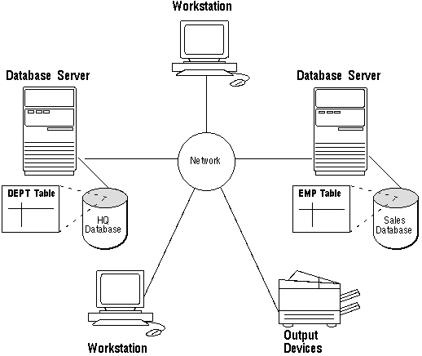

A challenge in distributed system
An application is deployed on multiple nodes that form a cluster.
Appears as one to the user.
The nodes in the cluster may or may not have the same computing capacity.
With different configurations and capabilities, how do we ensure minimized response times and reduce idle time of CPU?
Answer: Load Balancer

Slide 3
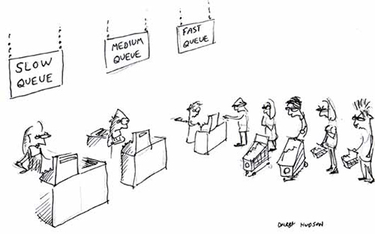

Role of a Load Balancer
It is a software or hardware component that distributes the workload amongst the nodes.
Ensures no single server is overloaded.
Evenly distributes the load on each server based on their capacity.
Acts as a single point of entry for the end user
Complexities of redirection is abstracted from users.
Increases reliability, efficiency, scalability, reusability, and availability.

Slide 4




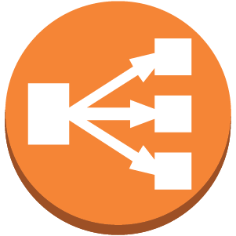

Examples of Load Balancers
NetScaler Resonate NGINX Plus Zen Load Balancer Amazon ELB BalanceNG LVS F-5 Big-IP Local Traffic Manager Cisco Load Balancer Barracuda Load Balancer ADC

Slide 5
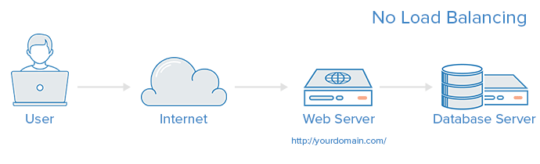
Web Server without load balancer
In this monolithic architecture, as the number of users trying to access the server simultaneously increases , chances of failing to service user requests with optimal response times increases.
Users may experience slow load times or something worse.

Slide 6

To Avoid This..
A website with significant traffic will benefit from a distributed architecture with a load balancer

Slide 7
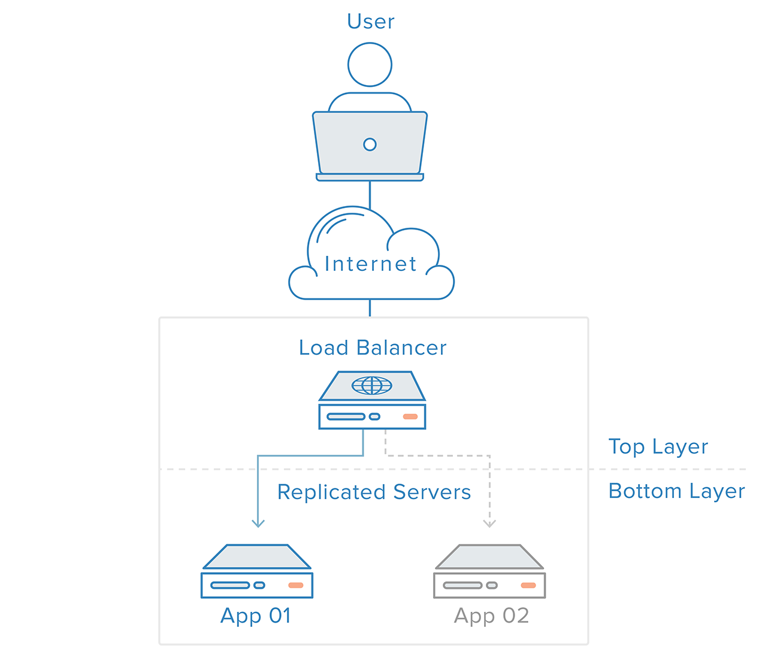
Distribute load between servers
To manage the incoming traffic:
Load balancer listens on a port for incoming traffic from clients (e.g., a user’s browser).
Redirects any incoming client request (e.g., a HTTP GET request) to one of the many servers in the cluster.
Server responds to the load balancer which is redirected back to the client.
This is typically a software load balancer
Benefits: hides the topology of the network/cluster from the client, providing some security. Faster response time for each client.

Slide 8
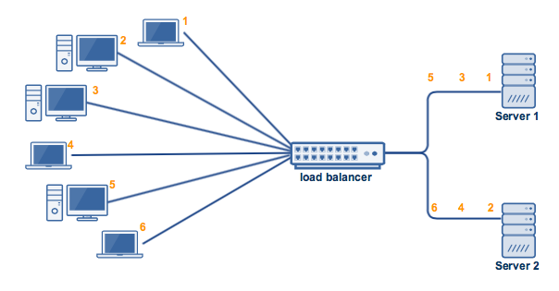
Software Load-Balancer
Installed on all serving nodes
Implement a combination of scheduling algorithms such as Round-Robin and Least Connection First
Weighted round-robin and weighted least connection.
Useful when the servers/nodes have different capabilities (e.g. processing power/RAM).
Weight associated with the server depends on the hardware capabilities
Round Robin
Notes:
incoming request first assigned to the server that is handling the least number of connections.
Each server would have a weight associated with it, which could be based on the hardware capability of that server. This would result in the server with better capabilities getting more request, while those with subprime capabilities getting fewer request

Slide 9

Drawbacks
Could be sensitive to OS versions
Virtual appliance deployments could experience hypervisor dependencies
Server’s RAM and CPU

Slide 10
Hardware Load-Balancer
Specialized routers or switches deployed between servers and clients
Rely on firmware to supply the internal code base - the program
Routing is either randomized (e.g., round-robin), or based on factors such as
available server connections,
server processing power,
resource utilization
Also knows as layer 4-7 router since they are implemented on Transport layer and Application layer of OSI model

Slide 11
Drawbacks
Cost becomes considerable when global server load balancing or cross data center load balancing needs to be done
At least one appliance in each of the data centers
A central box to manage load distribution between those appliances

